Slide 1
Text in Databases Charles Severance www.pg4e.com/lectures/04-Text.sql

Slide 2
Character Sets

Slide 3
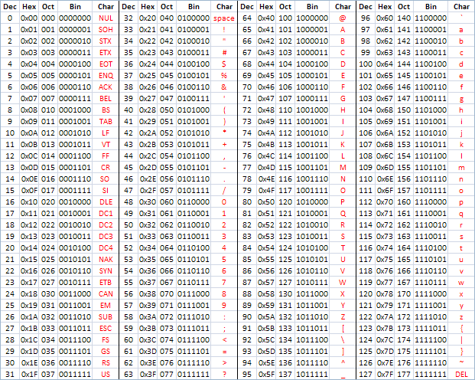
ASCII
American Standard Code for Information Interchange
https://en.wikipedia.org/wiki/ASCII
http://www.catonmat.net/download/ascii-cheat-sheet.png

Slide 4
Representing Simple Strings
"In the old days" - each character is represented by a number between 0 and 127 stored in 8 bits of memory
We refer to "8 bits of memory as a "byte" of memory
The ascii() function tells us the numeric value of a single ASCII character
The chr() function maps from an integer to a character
discuss=> select ascii('H'), ascii('e'), ascii('l'), chr(72), chr(42);
ascii | ascii | ascii | chr | chr
-------+-------+-------+-----+-----
72 | 101 | 108 | H | *

Slide 5
discuss=> select ascii('H'), ascii('e'), ascii('l'), chr(72), chr(42);
ascii | ascii | ascii | chr | chr
-------+-------+-------+-----+-----
72 | 101 | 108 | H | *
In the 1960s and 1970s, we just assumed that one byte was one character

Slide 6
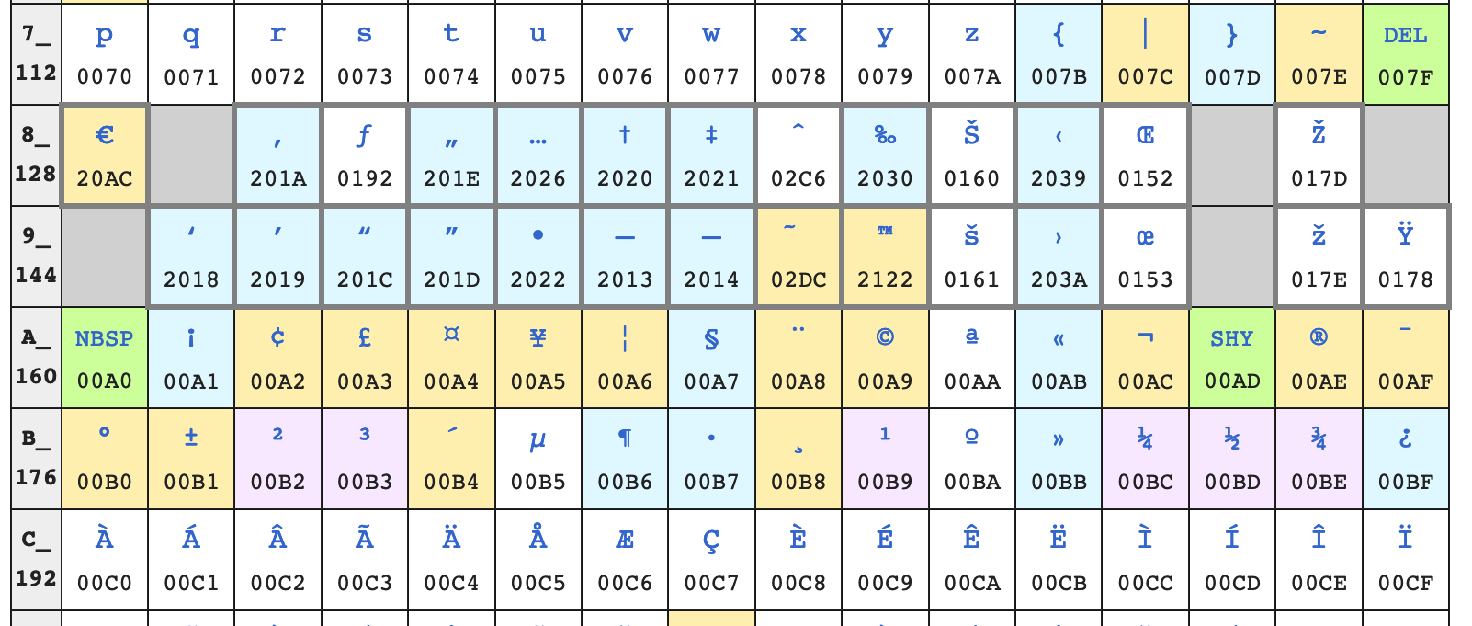
Beyond 127…
To be "more international" they defined characters 128-255 but inconsistently
https://en.wikipedia.org/wiki/ISO/IEC_8859-1 (latin1)
https://en.m.wikipedia.org/wiki/Windows-1252
Don't cut and paste code or text from PDFs ☹

Slide 7
To be even more international
We needed more than 128 new characters globally so 128-255 could mean different things based on context
ISO 8859-2 for Eastern European languages
ISO 8859-3 for Turkish, Maltese and Esperanto
ISO 8859-5 for Cyrillic
But these were not self-documenting you needed to know the character set outside the data of the file ---- Confusion

Slide 8
Unicode – All Characters in One Set
Unicode is 32 / 21 bits (long story)
H – 72 (ASCII is the first 128 values of Unicode)
ç - 231
中 – 20013
Unicode 12.1
137,000 characters
150 modern and historic character sets
https://en.wikipedia.org/wiki/List_of_Unicode_characters

Slide 9
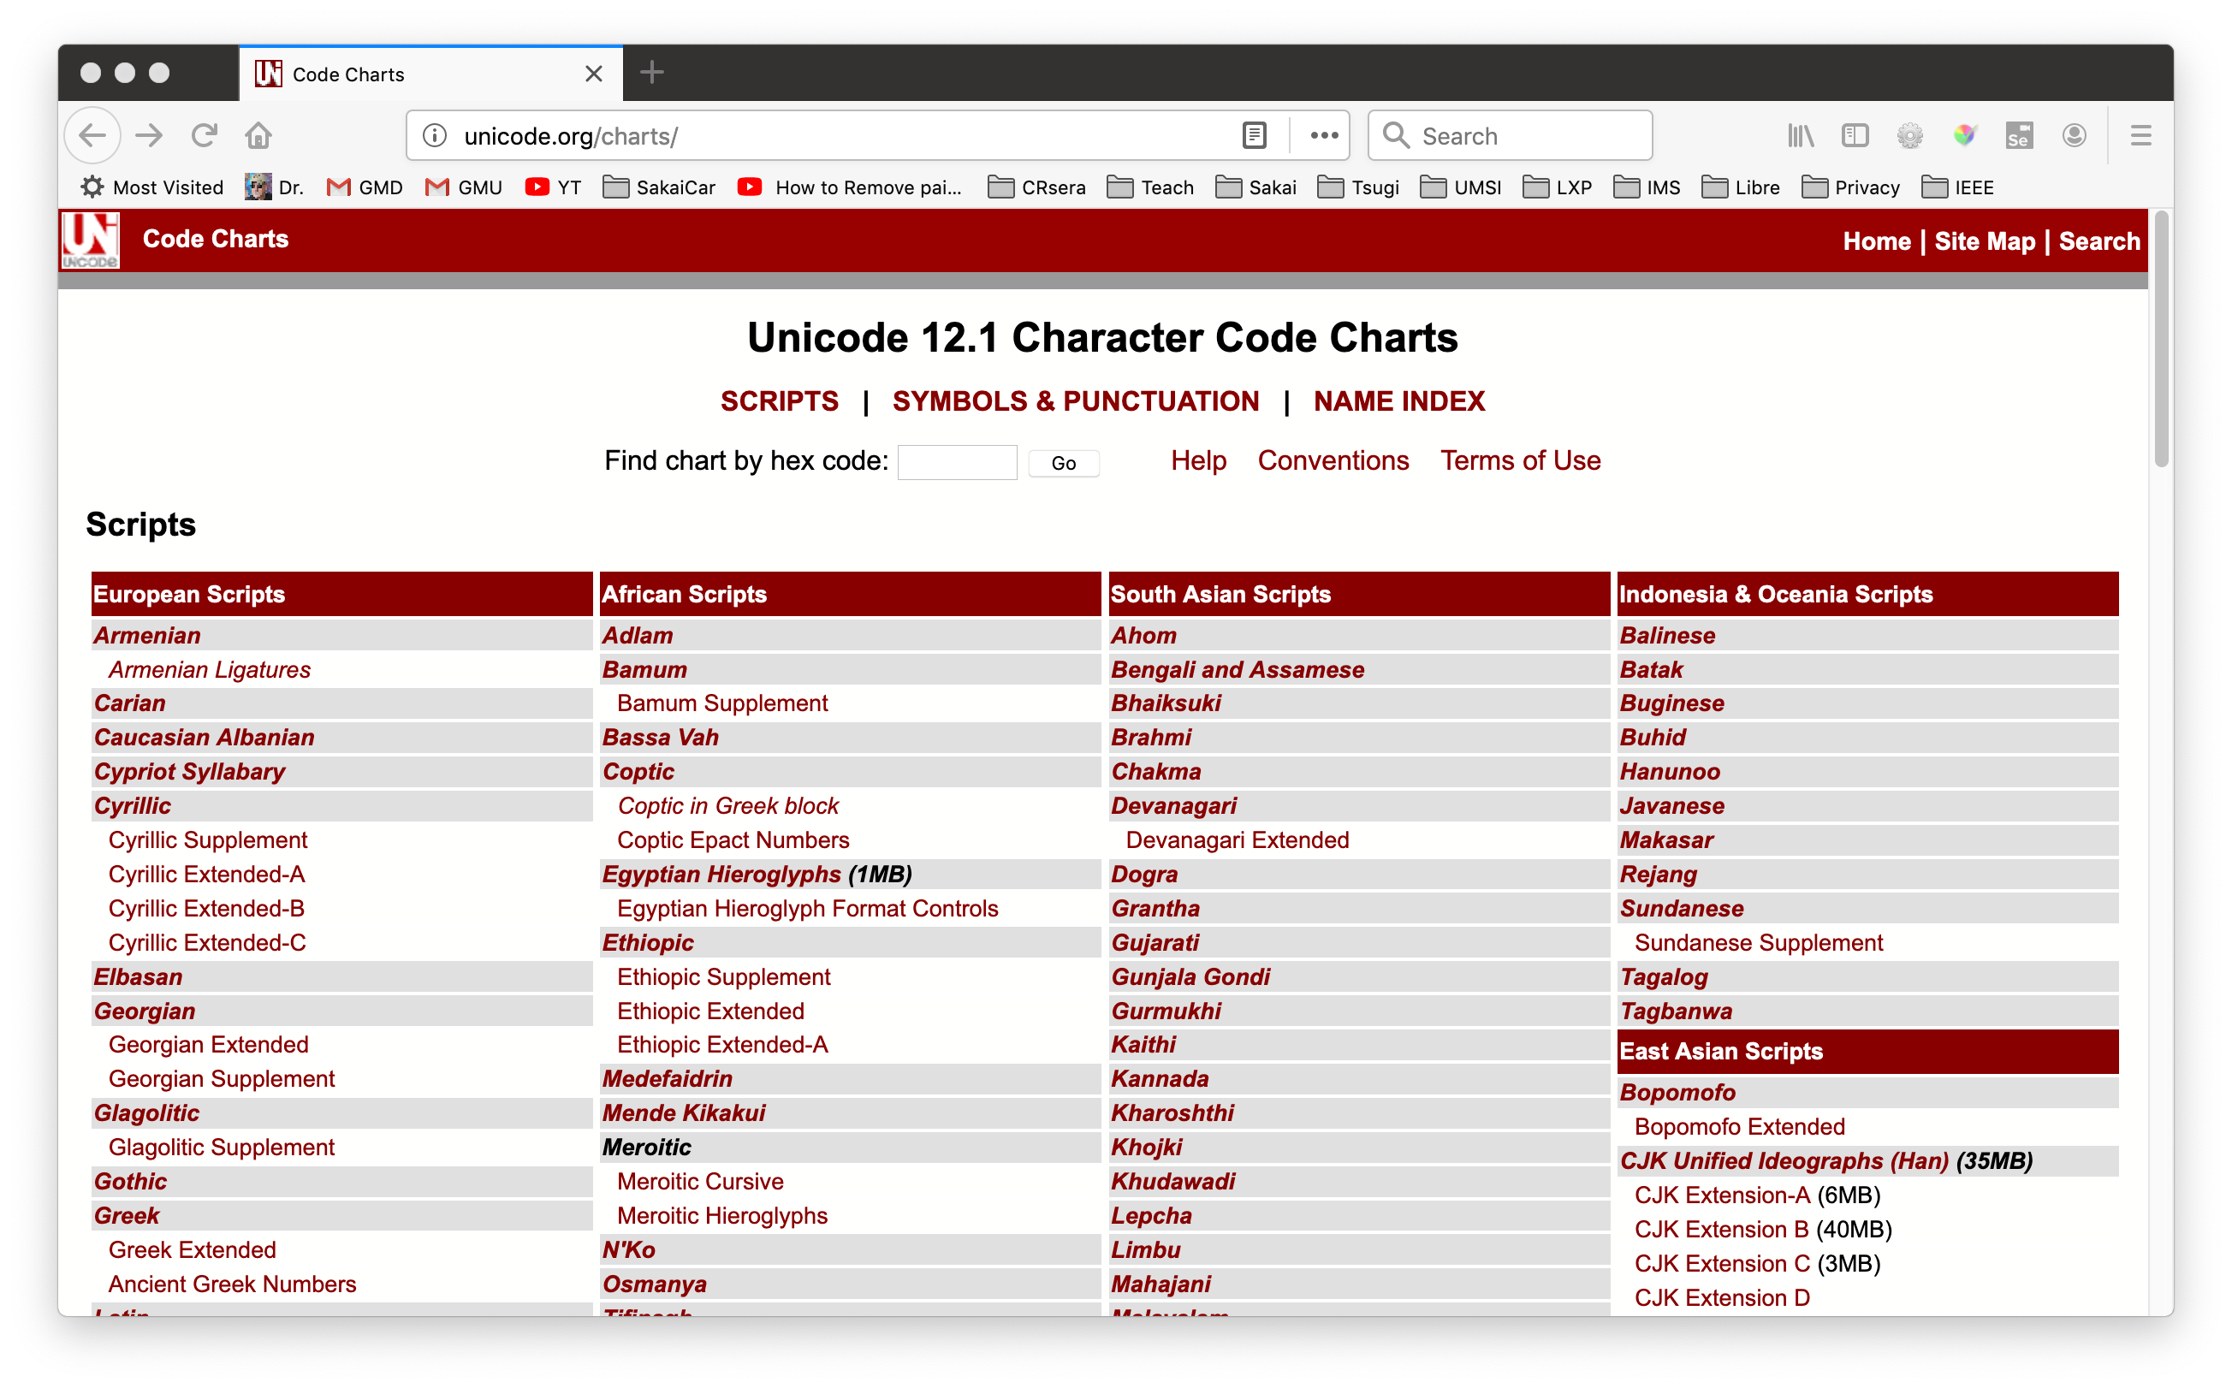
http://unicode.org/charts/

Slide 10
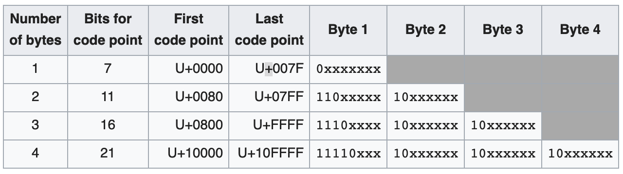
We can't afford 32 bit characters
UTF-8 is a compression scheme for Unicode
Represents 21 bits in 8-32 bits
0-128 are ASCII
128-255 are signals
https://en.wikipedia.org/wiki/UTF-8

Slide 11
UTF-8 Has Transition Features
ASCII is UTF-8 / No Conversion
You could often detect and auto convert some of
Latin-1
Some of 1252

Slide 12
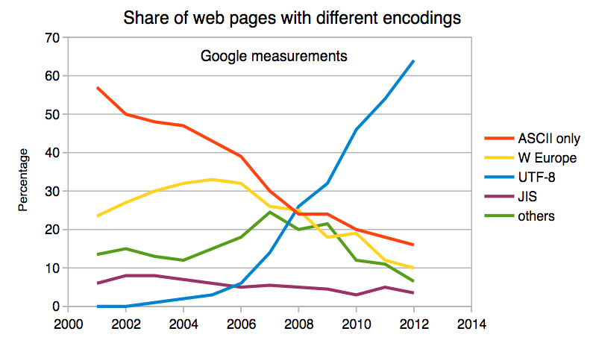
UTF-8 Is Everywhere
UTF-8 is 94% of all web pages in 2019
https://w3techs.com/technologies/details/en-utf8/all/all

Slide 13
Character Sets In Python

Slide 14
Python 3 and Unicode
>>> x = b'abc'
>>> type(x)
<class 'bytes'>
>>> x = '이광춘'
>>> type(x)
<class 'str'>
>>> x = u'이광춘'
>>> type(x)
<class 'str'>
Strings in memory are Unicode
The "bytes" type is for 8-bit characters
Strings "at rest" are generally stored UTF-8 for space and interoperability
Files
Network resources
Database tables

Slide 15
PYTHON
UNICODE
UTF-8 NETWORK
DATA
DECODE
UTF-8 FILE
DATA
DECODE
ENCODE
ENCODE
UTF-8
DATABASE
DATA
DECODE
ENCODE

Slide 16
Opening a File
open(file, mode='r', buffering=-1,
encoding=None, errors=None, newline=None,
closefd=True, opener=None)
encoding is the name of the encoding used to decode or encode the file. This should only be used in text mode. The default encoding is platform dependent (whatever locale.getpreferredencoding() returns), but any text encoding supported by Python can be used. See the codecs module for the list of supported encodings.
https://docs.python.org/3/library/functions.html#open

Slide 17
Reading Network Data
When we read data from an network resource, we must decode it based on the character set so it is properly represented in Python 3 as a UNICODE string
while True:
data = mysock.recv(512)
if ( len(data) < 1 ) :
break
mystring = data.decode()
print(mystring)

Slide 18
Database Data
When you interact with a database from Python all conversion between Unicode and UTF-8 is done implicitly
The Python database connector (i.e. psycopg2) knows the internal storage format of the database and automatically handles all conversion

Slide 19
Hashes

Slide 20
A hash function is any function that can be used to map data of arbitrary size onto data of a fixed size.
https://en.wikipedia.org/wiki/Hash_function

Slide 21
Hashes Are Cool
Concatenation ||
Repeat (horiz)
generate_series() vertical

Slide 22
Generating Test Data

Slide 23
Concatenation ||
Repeat (horiz)
generate_series() vertical

Slide 24
Indexes and Performance

Slide 25
Date Types (Review)
DATE - 'YYYY-MM-DD'
TIME - 'HH:MM:SS'
TIMESTAMP - 'YYYY-MM-DD HH:MM:SS' (4713 BC, 294276 AD)
TIMESTAMPZ – "TIMESTAMP WITH TIME ZONE"
Built-in PostgreSQL function NOW()

Slide 26
Strings

Slide 27
Concatenation ||
Repeat (horiz)
generate_series() vertical

Slide 28
Reducing the result set
DISTINCT only returns unique rows in a result set – and row will only appear once
DISTINCT ON limits duplicate removal to a set of columns
GROUP BY is combined with aggregate functions like COUNT(), MAX(), SUM(), AVE() …

Slide 29
Sub-Queries

Slide 30
A query within an query
Can use a value or set of values in a query that are computed by another query
SELECT * FROM account
WHERE email='ed@umich.edu';
SELECT content FROM comment
WHERE account_id = 7;
SELECT content FROM comment
WHERE account_id = (SELECT id FROM account WHERE email='ed@umich.edu');

Slide 31
Concurrency

Slide 32
Transaction Topics
Lock strength UPDATE, NO KEY UPDATE
What to do when encountering a lock (WAIT), NOWAIT, SKIP LOCKED

Slide 33
Stored Procedures

Slide 34
Stored Procedures
A stored procedure is a bit of reusable code that runs inside of the database server
Technically there are multiple language choices but just use "plpgsql"
Generally quite non-portable
Usually the goal is to to have fewer SQL statements

Slide 35
Summary

Slide 36
https://www.postgresql.org/docs/11/sql-select.html
SELECT [ ALL | DISTINCT [ ON ( expression [, ...] ) ] ]
[ * | expression [ [ AS ] output_name ] [, ...] ]
[ FROM from_item [, ...] ]
[ WHERE condition ]
[ GROUP BY grouping_element [, ...] ]
[ HAVING condition [, ...]
[ ORDER BY expression [ ASC | DESC | USING operator ]
[ LIMIT { count | ALL } ] [ OFFSET start [ ROW | ROWS ] ]
[ FOR { UPDATE | NO KEY UPDATE | SHARE | KEY SHARE }
[ OF table_name [, ...] ] [ NOWAIT | SKIP LOCKED ] [...] ]

Slide 37
Acknowledgements / Contributions
These slides are Copyright 2019- Charles R. Severance (www.dr-chuck.com) as part of www.pg4e.com and made available under a Creative Commons Attribution 4.0 License. Please maintain this last slide in all copies of the document to comply with the attribution requirements of the license. If you make a change, feel free to add your name and organization to the list of contributors on this page as you republish the materials.
Initial Development: Charles Severance, University of Michigan School of Information
Insert new Contributors and Translators here including names and dates
Continue new Contributors and Translators here

